Slide 1



EXECUTIVE ALIGNMENT
SECURE CONSENSUS ON KEY DECISIONS

Slide 2



Why Alignment is Critical
Strategic Foundation
Reconciling Opinions
Integration plans draft off the direction set by senior management. Without clear signals from the top, teams lack the necessary framework to build detailed execution plans.
Early discussions are vital to reconcile divergent opinions among executives. Resolving these conflicts early prevents friction and delays during the high-pressure execution phase.
© 100-Day Advisors MandAPlaybook.com
1

Slide 3









Key Elements for Agreement
Strategy & Drivers
Guiding Principles
Non-Negotiables
Agreement on the core value drivers and overarching deal strategy.
Clear boundaries and objectives that must be met without compromise.
The fundamental rules that will govern all integration decisions.
© 100-Day Advisors MandAPlaybook.com
2

Slide 4
Building a Shared Vision
You need to achieve a
shared vision
of the end state. Teams must know where the finish line before they can plan
how to get there.
— Integration Planning Best Practices
© 100-Day Advisors MandAPlaybook.com
3

Slide 5






Defining the Finish Line
Success Definition
Clearly articulate what integration success looks like for all stakeholders.
Completion Criteria
Define the specific milestones that signal the integration is officially complete.
Clear Roadmap
Ensure every team member understands the target destination to avoid wasted effort.
© 100-Day Advisors MandAPlaybook.com
4

Slide 6





Dangers of Rushing Ahead
Teams that rush into planning without a defined end state are prone to significant operational risks.
Spinning wheels on low-value tasks.
Veering off on unproductive tangents.
Wasted resources and team burnout.
© 100-Day Advisors MandAPlaybook.com
5

Slide 7


Clear Direction from Above
Efficiency through Unity
For integrations to be effective, teams require unambiguous direction from senior leadership.
The Result: A streamlined process where every workstream is aligned with the executive vision, ensuring maximum efficiency and value capture.
© 100-Day Advisors MandAPlaybook.com
6

Slide 8


Get Rolling
Get everyone on the same page before you start planning.
Align. Plan. Execute.
© 100-Day Advisors MandAPlaybook.com
7

Slide 9
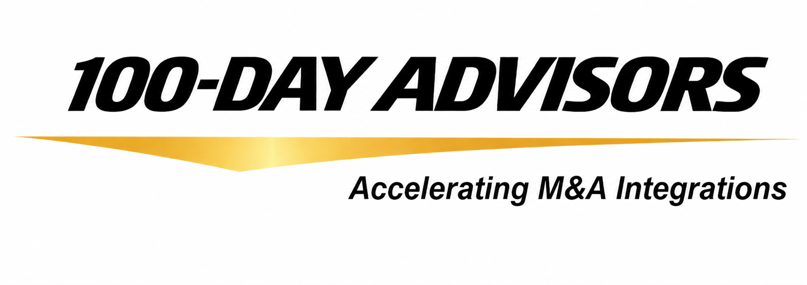


Consulting Inquiries:
Email: inquiries@100DayAdvisors.com
Website: MandAPlaybook.com/consulting
© 100-Day Advisors MandAPlaybook.com
6

